Slide 1

Unit-3: Multiple access in Wireless System
Mobile Computing Wireless Communication
(MCWC)
GTU # 3170710
PART-1 : Multiple access in Wireless System & GSM
Prof.Swati R Sharma
Computer Engineering Department
swati.sharma@darshan.ac.in
(O) 9727747317

Slide 2
Multiple access in Wireless System & GSM

Looping
Topics to be covered
Multiple access in Wireless System
Global system for mobile communication
GSM architecture
GSM entities
Call routing in GSM
PLMN interface
GSM addresses and identifiers
Network aspects in GSM
GSM frequency allocation
Authentication and security

Slide 3
Multiple access in Wireless System

Slide 4
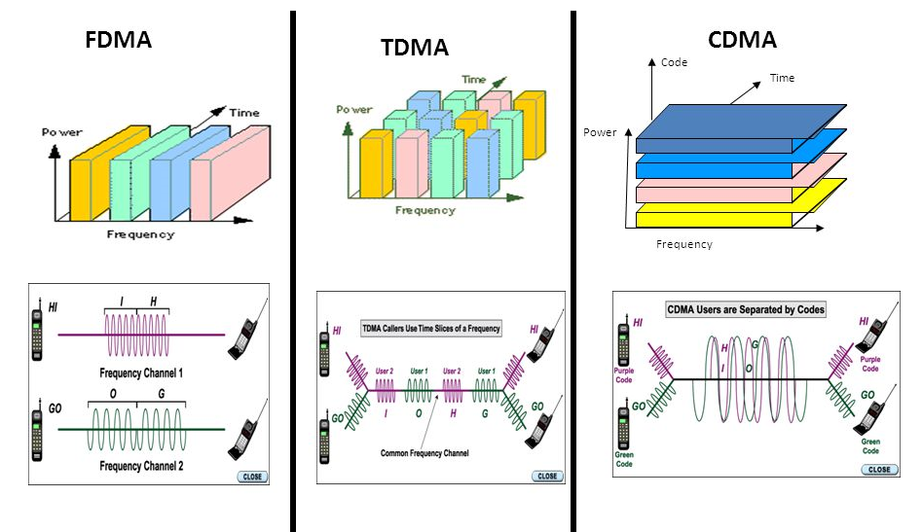
Multiple access in Wireless System

Slide 5
Global System for Mobile communication(GSM)

Slide 6
GSM vs CDMA
GSM | CDMA
Global System for Mobile communication | Code Division Multiple Access
Technology: FDMA & TDMA | CDMA
Data rate: 42Mbps in HSPA (3G) | Data rate: 3.6Mbps in CDMA
GSM supports transmitting data and voice together | CDMA doesn’t support it
Here customer information is stored in SIM card. | Here customer information is stored in Handset.
Global market share is 75% | Global market share is 25%
SIM specific. User can use/upgrade to multiple handset | Handset specific
Security is comparatively lower than CDMA | Provides more security as encryption is inherit feature
Support International roaming | CDMA doesn’t support this facility

Slide 7
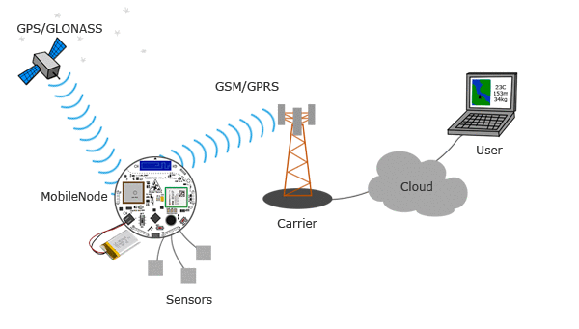
What is GSM?
GSM (Global System for Mobile communications) is an open, digital cellular technology used for transmitting mobile voice and data services.
The concept of GSM emerged from a cell-based mobile radio system at Bell Laboratories in the early 1970s.
The use of harmonised spectrum across most of the globe, combined with GSM’s international roaming capability, allows travellers to access the same mobile services at home and abroad.
GSM enables individuals to be reached via the same mobile number in up to 219 countries.
Notes:
GLONASS: GLObal NAvigation Satellite System

Slide 8
Introduction to GSM
GSM is combination of TDMA (Time Division Multiple Access), FDMA (Frequency Division Multiple Access) and Frequency hopping.
GSM makes use of narrowband Time Division Multiple Access (TDMA) technique for transmitting signals.
GSM was developed using digital technology.
It has an ability to carry 64 kbps to 120 Mbps of data rates.
Presently GSM supports more than one billion mobile subscribers in more than 210 countries throughout the world.
Roaming is the ability to use your GSM phone number in another GSM network.
GSM owns a market share of more than 75% of the world's digital cellular subscribers.

Slide 9
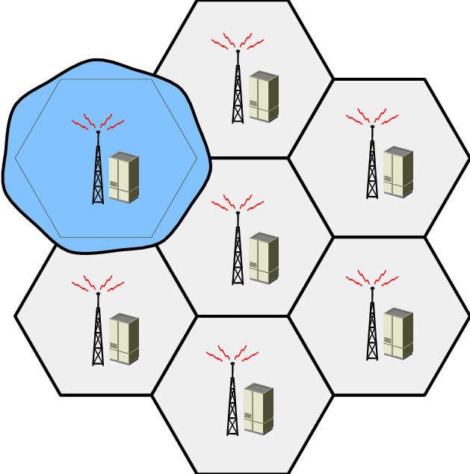
Introduction to GSM
In GSM, geographical area is divided into hexagonal cells whose side depends upon power of transmitter and load on transmitter (number of end user).
At the centre of cell, there is a base station consisting of a transceiver (combination of transmitter and receiver) and an antenna.

Slide 10
Why GSM?
Improved spectrum efficiency
International roaming
Low-cost mobile sets and base stations (BSs)
High-quality speech
Compatibility with Integrated Services Digital Network (ISDN) and other telephone company services
Support for new services
Ability to support handheld terminals
ISDN compatibility

Slide 11
History of GSM
Year | Event
1982 | Group of Special Mobile (GSM) established
1987 | Essential elements of wireless transmission specified
1989 | GSM becomes an ETSI technical committee
1990 | Phase 1 GSM 900 specification (designed 1987 through 1990) frozen
1991 | First GSM network launched
1993 | First roaming agreement came into effect
1994 | Data transmission capability launched
1995 | Phase 2 launched, Fax and SMS roaming services offered
2002 | SMS volume crosses 24 billion/year, 750 million subscribers
Notes:
ETSI:European Telecommunications Standards Institute

Slide 12
GSM Architecture

Slide 13
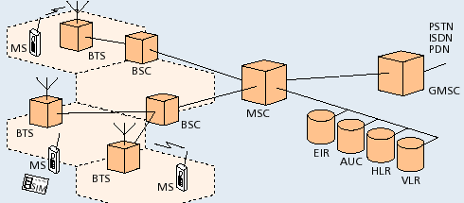
GSM Architecture
AUC | Authentication center
HLR | Home Location Register
PSTN | Public Switching Telephone Network
BSC | Base station controller
ISDN | Integrated System Digital Network
BTS | Base trans-receiver system
MS | Mobile station
VLR | Visitor Location Register
EIR | Equipment Identity Register
MSC | Mobile Switching Centre
GMSC | Gateway MSC
PDN | Packet Data Network

Slide 14
GSM Architecture
Operation &
Maintenance
Centre
OMC
ISC
PLMN & INTERNET
BSC
BTS
GMSC
PSTN
ISDN
PDN
MSC
VLR
BSC
BTS
HLR
AUC
BTS
EIR

Slide 15
GSM Architecture: Mobile Station (MS)
MS consists of following two components
Mobile Equipment (ME)
Mobile Subscriber Identity Module (SIM)
Removable plastic card
Stores Network Specific Data such as list of carrier frequencies and current LAI.
Stores International Mobile Subscriber Identity (IMSI) + ISDN
Stores Personal Identification Number (PIN) & Authentication Keys.
Also stores short messages, charging information, telephone book etc.
Allows separation of user mobility from equipment mobility

Slide 16
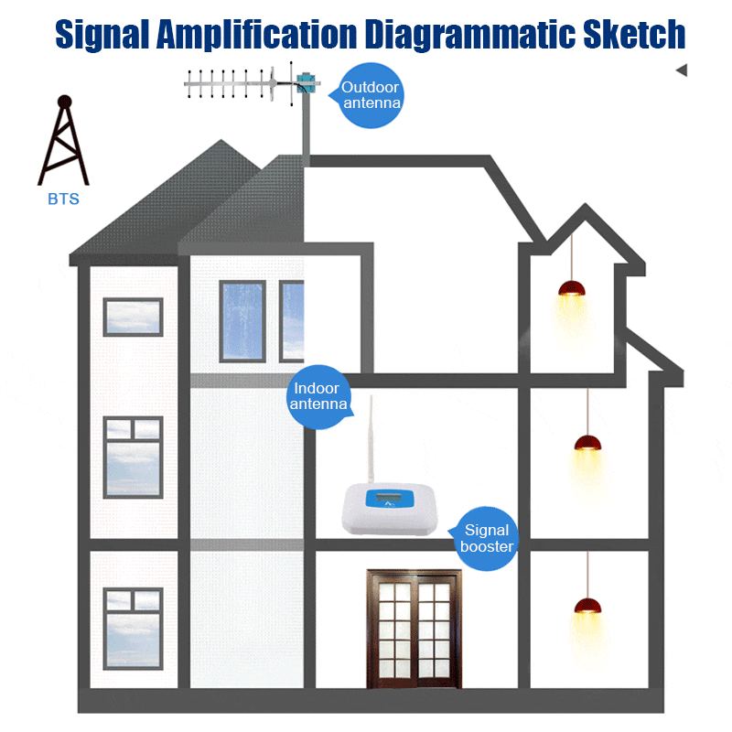
Base Transceiver Station (BTS)

Slide 17
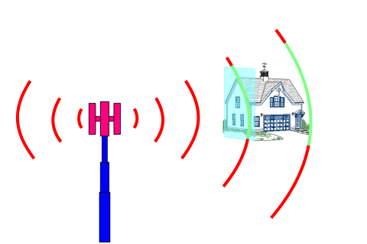
GSM Architecture: Base Transceiver Station (BTS)
One per cell
Consists of high speed transmitter and receiver
Its transmit power decides size of cell
Function of BTS
Provides two channels
Signalling and Data Channel
Performs error protection coding for the radio channel

Slide 18
GSM Architecture: Base Station Controller (BSC)
Controls multiple BTS
Functions of BSC
Performs radio resource management
Assigns and releases frequencies and time slots for all the MSs in its area
Reallocation of frequencies among cells
Hand over protocol is executed here
Time and frequency synchronization signals to BTSs
Time Delay Measurement and notification of an MS to BTS
Power Management of BTS and MS

Slide 19
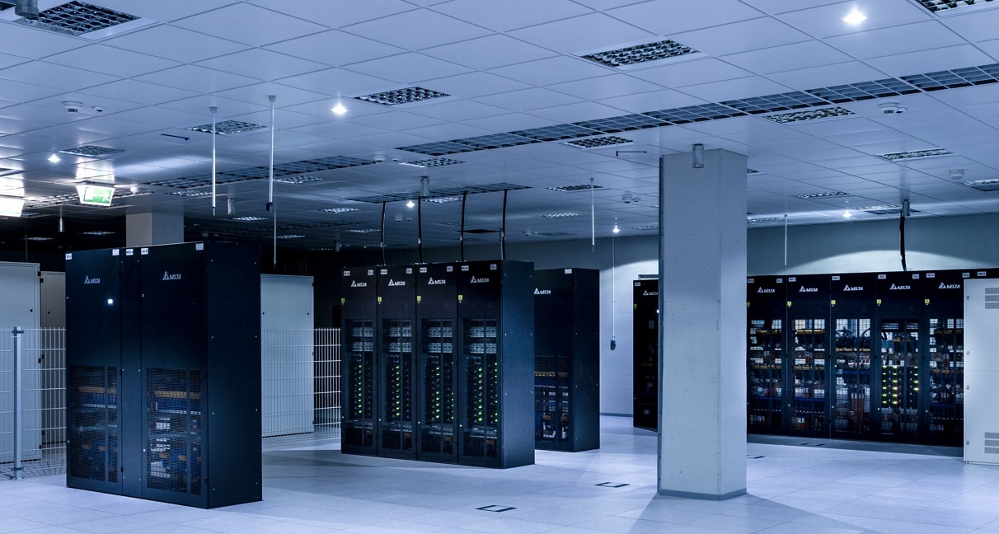
GSM Architecture: Mobile Switching Centre (MSC)
Switching node of a PLMN(Public Land Mobile Network)
Task of MSC
Registration
Authentication
Location updating
Handovers
Call routing
Mobility of subscribers
Location registration of subscriber
There can be several MSCs in a PLMN

Slide 20
GSM Architecture: Gateway MSC (GMSC)
Connects mobile network to a fixed network
Entry point to a PLMN
Usually one per PLMN
Request routing information from the HLR and routes the connection to the local MSC

Slide 21
GSM Architecture: Home Location Register(HLR)
For all users registered with the network, HLR keeps user profile.
Logically only one HLR per PLMN
Persistent storage of user data
MSCs exchange information with HLR
When MS registers with a new GMSC, the HLR sends the user profile to the new MSC
Includes information like
Current location of user
Authentication data
Service provisioning information
Power on status

Slide 22
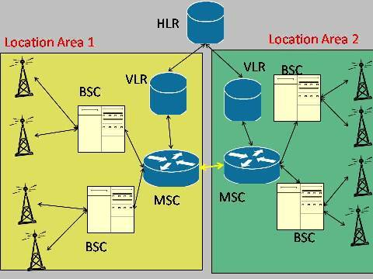
GSM Architecture: Visitor Location Register (VLR)
VLR is responsible for a group of location areas, typically associated with an MSC
Contains temporary information needed for call control typically copied from HLR.
When subscriber enters a new MSC, VLR associated with that MSC requests user info from corresponding HLR

Slide 23
GSM Architecture: AUC and EIR
AUC: Authentication Center
Accessed by HLR to authenticate a user for service
Contains authentication and encryption keys for subscribers
EIR: Equipment Identity Register
Allows stolen or fraudulent mobile stations to be identified

Slide 24
GSM System Hierarchy
Administrative Region
Public Land Mobile Network(PLMN)/ GSM Administrative Region
Mobile Switching Centre (MSC) Region
Registration, Authentication, location updating, handovers and call routing
Location Area
Location Area (LA)
Base Station Controller
Base Station Controller (BSC)
One LA consist of many cell groups & each cell group is assigned to one BSC
Cell
Cell
BSC
Location Area
One BSC can belong to different LA’s
MSC Region

Slide 25
GSM Entities

Slide 26
GSM Entities
Mobile Station (MS)
Mobile Equipment (ME)
Subscriber Identity Module (SIM)
Base Station Subsystem (BSS)
Base Transceiver Station (BTS)
Base Station Controller (BSC)
Network and Switching Subsystem (NSS)
Mobile Switching Center (MSC)
Home Location Register (HLR)
Visitor Location Register (VLR)
Equipment Identity Register (EIR)
Authentication Center (AUC)
Operation and Support Subsystem (OSS)
Operation and Maintenance Center (OMC)

Slide 27
GSM Entities
OSS
OMC
BSS
ISC
PLMN & INTERNET
BSC
BTS
GMSC
PSTN
ISDN
PDN
MSC
VLR
BSC
BTS
HLR
AUC
BTS
NSS
EIR

Slide 28
GSM Addresses and Identifiers

Slide 29
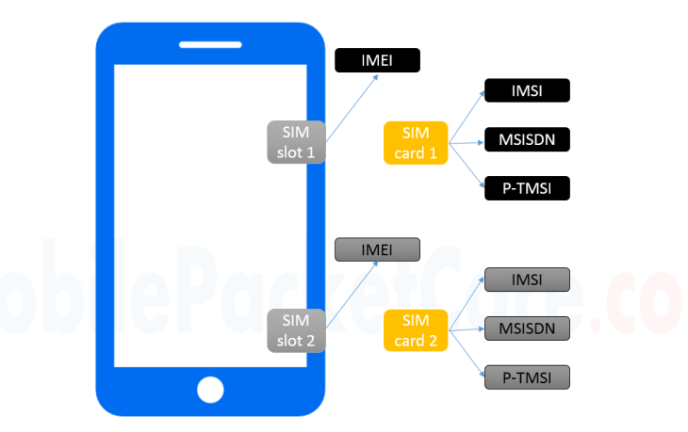
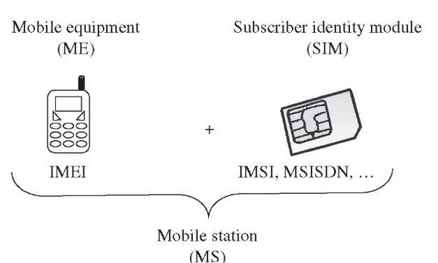
GSM Addresses and Identifiers: IMSI, IMEI, MSISDN
Notes:
TMSI-Temporary Mobile Subscriber Identity

Slide 30
GSM Addresses and Identifiers: IMSI number
IMSI: International Mobile Subscriber Identity
IMSI identifies registered smartphone users
A working SIM card has a valid IMSI
Each IMSI consists of three parts:
Mobile Subscriber Identification Number (MSIN)
identifies the subscriber in his or her mobile network.
Mobile Country Code (MCC)
It gets 3 decimal places and identifies the country of mobile device owner.
Mobile Network Code (MNC)
It identifies your carrier network
Maximum 15 digit
3 digits
2-3 digits
10 digits
MCC
MNC
MSIN
National MSI
IMSI

Slide 31
GSM Addresses and Identifiers: IMEI number
15-digit number to uniquely identify a mobile phone device.
Every mobile equipment in this world has a unique identifier which is called IMEI.
IMEI allocated by the equipment manufacturer and registered by the network operator in the Equipment Identity Register (EIR).

Slide 32
GSM Addresses and Identifiers: MSISDN number
Mobile Subscriber ISDN Number
MSISDN is primary key to the HLR record.
The MSISDN number is the real telephone number as is known to the external world.
MSISDN number is public information whereas IMSI is private to the operator. IMSI can be multiple such as when a subscriber opts for fax and data.
IMSI is assigned a total of three numbers: one for the voice call, one for a fax call and another for the data call.
MSISDN follows the international ISDN (Integrated Systems Data Network) numbering plan.
3 digits
2-3 digits
Max. 10 digits
CC
NDC
SN
MSISDN
Country Code - CC
National Destination Code - NDC
Subscriber Number - SN

Slide 33
GSM Addresses and Identifiers: Location Area Identity (LAI)
Each LA in a PLMN has own identifier called Location Area Identifier (LAI) which is structured hierarchically and unique.
Example: 502-20-60001
3 digits
2 digits
1 to 65536
MCC
MNC
LAC
LAI
Mobile Country Code - MCC
Mobile Network Code - MNC
Location Area Code - LAC

Slide 34
GSM Addresses and Identifiers: Mobile Station Roaming Number (MSRN)
When a subscriber is roaming in another network, a temporary ISDN number assigned to the subscriber called MSRN.
MSRN assigned by the local VLR in charge of the mobile station and follows the structure of MSISDN.

Slide 35
GSM Addresses and Identifiers
Temporary Mobile Subscriber Identity (TMSI): TMSI is a temporary identifier assigned by the serving VLR used in place of the IMSI for identification and addressing of the mobile station.
Together with the current location area, a TMSI allows a subscriber to identified uniquely.
Local Mobile Subscriber Identity (LMSI): LMSI assigned by the VLR and stored in the HLR and used as a searching key for faster database access within the VLR.
Cell Identifier: Within an LA, every cell has a unique Cell Identifier (CI) together with an LAI, a cell can be identified uniquely through Global Cell Identity (LAI & CI).

Slide 36
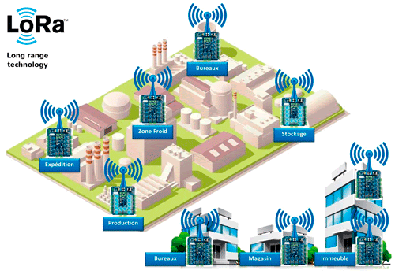
Call Routing in GSM

Slide 37
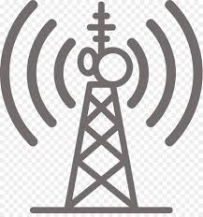




HLR
VLR
MSC
HLR
VLR
AUC
EIR
MS
AUC
EIR
MSC
BTS
MS
BSC
MS
BTS
MS
MS
MS
BTS
BTS
MS
MS
MS
MS
GMSC
BSC
BTS
BTS
MS
MS
BSC
MS
MS
BTS
BTS
PSTN
MS
MS
MS
BTS
MS
Call Routing in GSM

Slide 38
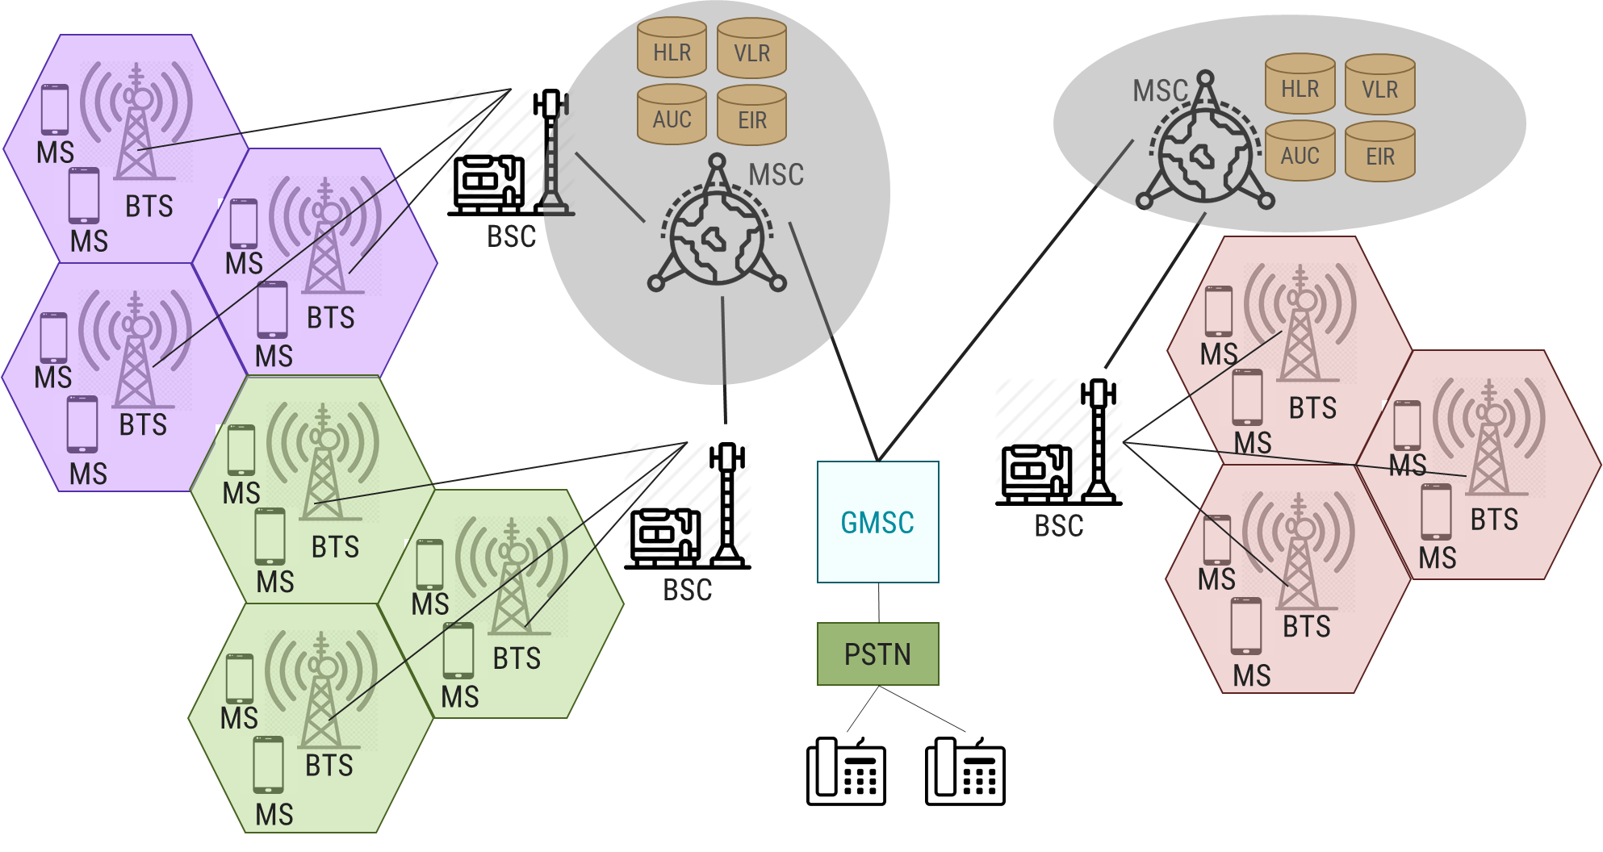
Call Routing in GSM: Mobile Phone to Public Switched Telephone Network
Mobile phone subscriber will dial a number on PSTN network
To identify the communicating network the MSC will receive the message of a call request through BTS and BSC respectively.
The MSC checks if the MS is authorized to access the destination network. If YES, then Destination MS is activated, else the service will be denied.
MSC will ask the destination BSC to allocate a traffic channel (radio channel + time slot)
The destination BSC will then allocates the traffic channel and pass the information to PSTN telephone.

Slide 39
Call Routing in GSM: Mobile Phone to Public Switched Telephone Network
The called party answers the call and the conversation takes place
The MS keeps on taking measurements of the radio channels in the present cell and the neighbouring cells and passes the information to the BSC.
The BSC decides if a handover is required.
If so, a new traffic channel is allocated to the mobile station and the handover takes place.
If handover is not required, the mobile station continues to transmit in the same frequency.

Slide 40
Call Routing in GSM
Fixed Subscriber | PSTN/ISDN Exchange | Gateway MSC | Home Location Register | PSTN/ISDN Exchange | MSC/VLR | Mobile Station
MSISDN
MSISDN
IMSI
MSISDN
MSRN
MSRN
MSRN
MSRN
TMSI
MSISDN: Mobile Subscriber ISDN | IMSI: Iinternational Mobile Subscriber Identity
TMSI: Temporary Mobile Subscriber Identity | MSRN:Mobile Station Roaming Number

Slide 41
Call Routing: Mobile-originated

Slide 42
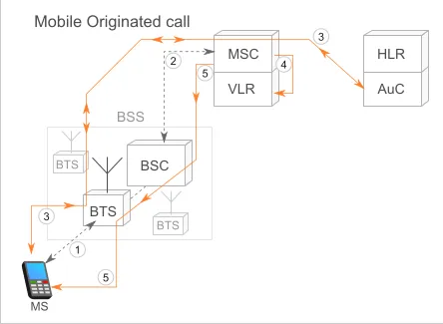
Mobile-originated call
Step-1 | To initiate a call, the MS request for radio resource allocation to the BSS, which mediates further connection to the Mobile Switching Center (MSC). The BSS assigns the MS a channel with a given frequency and time slot.
Step-2 | BSS initiate the connection to the MSC.
Step-3 | Now as MS had connected to the network, the subscriber needs to be authenticated. As IMSI number is stored in MS SIM card, AUC will verify subscriber’s identity. Thus, MS and MSC are now connected. MSC initiates a ciphering procedure which is transmitted to the BTS, which in turn forwards the message to the MS. it will start the ciphered transmission of information, finalizing the encryption procedure.
Step-4 | MSC verifies that the requested service is allowed for the subscriber. This information is available in VLR. Once the VLR confirms the service requested by the originating MS, the MSC starts the call setup.

Slide 43
Mobile-originated call
Step-5 | MSC allocates a voice channel between the MSC and the BSS. The MSC routes the call to the dialed number. When the call is received in the PSTN, the MSC is notified that the called subscriber is being alerted, at which point the originating MS receives a ring notification.
Step-6 | To disconnect the call by either party, a disconnect message is sent to the MSC, which releases the communication channels created with the PSTN and the BSS

Slide 44
Call Routing: PSTN-originated

Slide 45
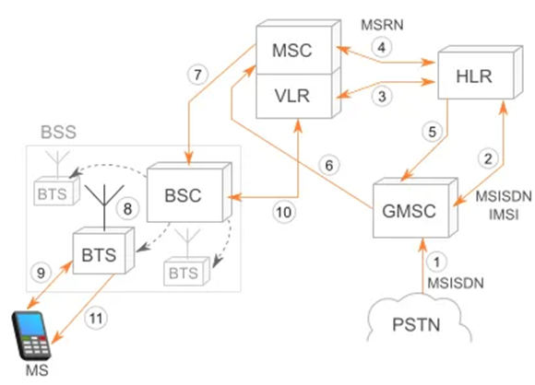
PSTN-originated call
Step-1 | When a call is placed from the PSTN, the PSTN uses the information in the phone number (country and if available, operator) to locate GMSC leading to the MSC where the subscriber is registered.
Step-2 | GMSC can request information about the subscriber’s core network and current location by interrogating the HLR.
Step-3 | HLR constantly updates locations of the MS stored in the VLRs of the networks the MS visits. In the HLR, the subscriber MSISDN (phone number) is associated with the IMSI number of the SIM card, which was used to authenticate the subscriber in the visited network as they registered. HLR is aware of the visited MSC/VLR of the MS at a given time.
Step-4 | In order for the GMSC to pass the call to the MSC, the HLR asks a temporary roaming phone number(MSRN) from the MSC. (Mobile Station Roaming Number – MSRN).
Notes:
Reference:https://yatebts.com/documentation/concepts

Slide 46
PSTN-originated call
Step-5 | MSRN is sent back from the HLR to the GMSC.
Step-6 | GMSC forward the call to the MSC using the assigned MSRN.
Step-7 | MSC pages all the BSCs in the area that it serves.
Step-8 | Then BSC, in turn, page the BTSs assigned to them.
Step-9 | Called MS responds to the paging from the BTS, asking to establish a radio channel to the BTS.
Step-10 | Response is forwarded to the MSC, which, once notified, authenticates the MS and initiates the ciphering of the call
Step-11 | MSC sends back to the radio network the call confirmation message, the called MS starts to ring.
Step-12 | Then, MSC notifies the GMSC, which notifies the PSTN that the destination number is being alerted.
Notes:
Reference:https://yatebts.com/documentation/concepts

Slide 47
PLMN Interface

Slide 48
PLMN Interface
HLR
SP
SP
EIR
SS#7 Network
&
Leased Line
AUC
SP
MSC
SP
SP
SP
GMSC
PSTN
ISD
PDN
VLR
MSC
VLR
VLR
BSC
Signaling Data
BTS
User data
BTS

Slide 49
PLMN Interface
A basic configuration of a GSM network contains a central HLR and a central VLR, where
HLR contains all security, provisioning and subscriber related information
VLR stores the location information and other transient data.
MSC needs subscriber parameter for successful call set-up.
Any data related to user call (connection, teardown, etc.) processed with the SS7 protocol for signaling.
For mobile specific signaling, a protocol stack called MAP (Mobile Application Part) used over the SS7 network which does all database transactions and handover/roaming transactions between the MSC.
MSC uses registers known as SP – Signaling Point.

Slide 50
GSM Handoff

Slide 51
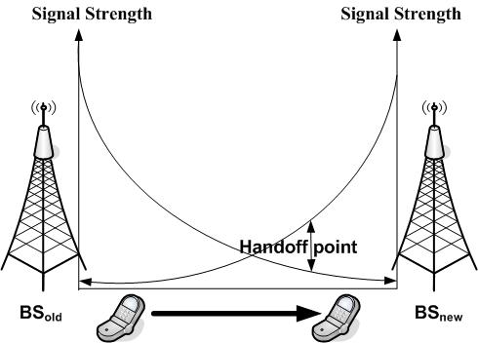
Handoff
In cellular communications, the terms handover or handoff refers to the process of transferring ongoing call or data connectivity from old Base Station to new Base Station.
When a mobile moves into the different cell while the conversation is in progress then the MSC (Mobile Switching Centre) will transfer the call to a new channel belonging to the new Base Station.
When a mobile user A moves from one cell to another cell then BTS 1 signal strength loses for the mobile User A and the signal strength of BTS 2 increases and thus ongoing calls or data connectivity for mobile user goes on without interrupting.

Slide 52
Why Handoff?
Two Reasons
When The Radio Signal’s quality and power decreases to necessary scores, the connection deliver to more powerful cell
When the Traffic Capacity approaches to maximum, the connection deliver to less density of traffic cell

Slide 53
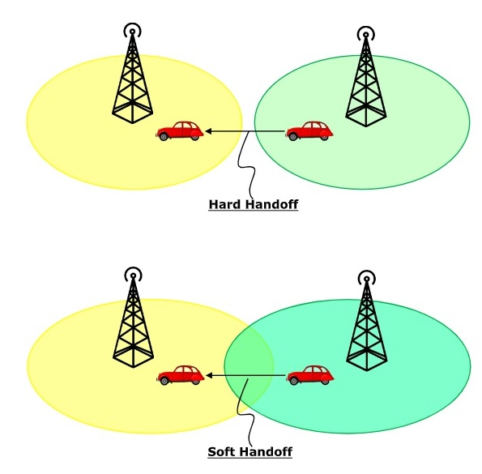
Handoff Types: Soft Handoff vs Hard Handoff
Hard Handoff | Soft Handoff
Break in the connection occurs while switching from one cell to another. | Break in the connection will not occur due to overlapping cells.
The radio links from the mobile station to the existing cell is broken before establishing a link with the next cell. | In soft handoff, at least one of the links is kept when radio links are added and removed to the mobile station.
It is a “break before make” policy. | It is a “make before break” policy.

Slide 54
Type of Handover/Handoff
Four types of handover in GSM:
OMC
ISC
PLMN & INTERNET
BSC
BTS
GMSC
PSTN
ISDN
PDN
MSC
MSC
BSC
BTS
VLR
HLR
BTS
AUC
EIR
3. Inter-BSC handover
4. Inter-MSC handover
2. Inter-cell handover
1. Intra - Cell Handover

Slide 55
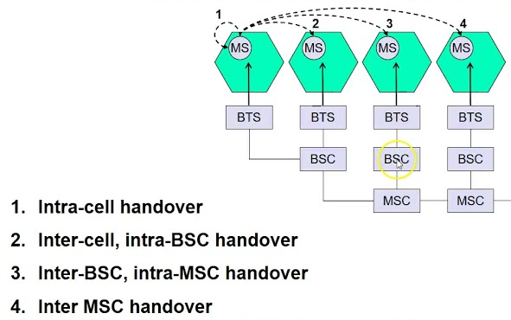
Handoff Types

Slide 56
Network Aspects in GSM

Slide 57
Network aspects in GSM: Signalling Protocol Structure
GSM architecture is a layered model that is designed to allow communications between two different systems.
The lower layers assure the services of the upper-layer protocols.
Each layer passes suitable notifications to ensure the transmitted data has been formatted, transmitted, and received accurately.
Um
A
CM MM RR
LAPDm
TDMA
CM MM BSSMAP
SCCP
MTP
GSM
Layer 3
Abis
RR
LAPDm
TDMA
BSSMAP
SCCP
MTP
Layer 2
Layer 1
Mobile Station
BTS
BSC
MSC

Slide 58
Network aspects in GSM: Signalling Protocol Structure
GSM signalling protocol is categorized into three general layers:
Layer 1 - physical layer: It uses the channel structures over the air interface.
Layer 2 - The data-link layer: Across the Um interface, the data-link layer is a modified version of the Link access protocol for the D channel (LAP-D) protocol used in ISDN, called Link access protocol on the Dm channel (LAP-Dm). Across the A interface, the Message Transfer Part (MTP), Layer 2 of SS7 is used.
Um
A
CM MM RR
LAPDm
TDMA
CM MM BSSMAP
SCCP
MTP
GSM
Layer 3
Abis
RR
LAPDm
TDMA
BSSMAP
SCCP
MTP
Layer 2
Layer 1
Mobile Station
BTS
BSC
MSC

Slide 59
Network aspects in GSM: Signalling Protocol Structure
The GSM signalling protocol is categorized into three general layers:
Layer 3 : GSM signalling protocol’s third layer is divided into three sublayers:
Radio Resource Management (RR): It controls the set-up, maintenance, and termination of radio and fixed channels, including handovers.
Mobility Management (MM):It manages the location updating and registration procedures as well as security and authentication.
Connection Management (CM): It handles general call control and manages Supplementary Services and the Short Message Service(SMS).
Um
A
CM MM RR
LAPDm
TDMA
CM MM BSSMAP
SCCP
MTP
GSM
Layer 3
Abis
RR
LAPDm
TDMA
BSSMAP
SCCP
MTP
Layer 2
Layer 1
Mobile Station
BTS
BSC
MSC

Slide 60
Network aspects in GSM: Signalling Protocol Structure
MS to BTS Protocols
RR layer :
Manages a link, both radio and fixed, between the MS and the MSC
Manages the RR-session, the time when a mobile is in a dedicated mode, and the radio channels including the allocation of dedicated channels.
MM layer: Stacked above the RR layer
Handles the functions that arise from the mobility of the subscriber
Authentication and security aspects
Location management
A
Um
CM MM RR
LAPDm
TDMA
CM MM BSSMAP
SCCP
MTP
GSM
Layer 3
Abis
RR
LAPDm
TDMA
BSSMAP
SCCP
MTP
Layer 2
Layer 1
Mobile Station
BTS
BSC
MSC

Slide 61
Network aspects in GSM: Signalling Protocol Structure
MS Protocols
CM Layer: Call Management(CM) is topmost layer of the GSM protocol stack
Responsible for Call Control, Supplementary Service Management, and Short Message Service Management.
Handles call establishment, selection of the type of service (including alternating between services during a call), and call release.
LADPm: Lightweight Authentication and Delegation Protocol
A
LAPDm is a data link layer protocol used in GSM cellular networks.
forms Layer 2 of Um interface between the BTS and MS
CM MM RR
LAPDm
TDMA
Um
CM MM BSSMAP
SCCP
MTP
GSM
Layer 3
Abis
RR
LAPDm
TDMA
BSSMAP
SCCP
MTP
Layer 2
Layer 1
Mobile Station
BTS
BSC
MSC

Slide 62
Network aspects in GSM: Signalling Protocol Structure
Um interface
The Um interface is the air interface of the GSM mobile telephone standard.
It is the interface between the mobile station (MS) and the Base transceiver station (BTS).
It is known as Um because it is the mobile analog to the U interface of ISDN.
Um is defined in the GSM 04.xx and 05.xx series of specifications.
Um can also support GPRS packet-oriented communication.
Um
A
CM MM RR
LAPDm
TDMA
CM MM BSSMAP
SCCP
MTP
GSM
Layer 3
Abis
RR
LAPDm
TDMA
BSSMAP
SCCP
MTP
Layer 2
Layer 1
Mobile Station
BTS
BSC
MSC

Slide 63
Network aspects in GSM: Signalling Protocol Structure
BSC Protocols: Uses a different set of protocols after receiving the data from BTS.
Abis interface: Used between the BTS and BSC.
Allows control of the radio equipment and radio frequency allocation in the BTS.
BSSMAP: Base Station System Management Application Part
Designed for signalling over the A interface
Supports both connectionless and connection-oriented services provided by the SCCP
Supports messages sent between the MSC and the BSS, as well as transparent message transfer between the MSC and the MS
Um
A
CM MM RR
LAPDm
TDMA
CM MM BSSMAP
SCCP
MTP
GSM
Layer 3
Abis
RR
LAPDm
TDMA
BSSMAP
SCCP
MTP
Layer 2
Layer 1
Mobile Station
BTS
BSC
MSC

Slide 64
Network aspects in GSM: Signalling Protocol Structure
BSC Protocols: Uses a different set of protocols after receiving the data from BTS.
SCCP: Signalling Connection Control Part (SSCP) is a network layer protocol
Provides extended routing, flow control, segmentation, connection-orientation, and error correction facilities in Signaling System 7 (SS7) telecommunications networks.
SCCP relies on the services of MTP for basic routing and error detection.
MTP: Message Transfer Part
Part of the Signalling System 7 (SS7) used for communication in Public Switched Telephone Networks (PSTN).
MTP is responsible for reliable, unduplicated and in-sequence transport of SS7 messages between communication partners.
Um
A
CM MM RR
LAPDm
TDMA
CM MM BSSMAP
SCCP
MTP
GSM
Layer 3
Abis
RR
LAPDm
TDMA
BSSMAP
SCCP
MTP
Layer 2
Layer 1
Mobile Station
BTS
BSC
MSC

Slide 65
Network aspects in GSM: Signalling Protocol Structure
MSC Protocols
A interface:
Used to provide communication between the BSS and the MSC.
The interface carries information to enable the channels, timeslots and the like to be allocated to the mobile equipment's being serviced by the BSSs.
At the MSC, starting from the BSC, the information is mapped across the A interface to the MTP Layers 1 through 3.
Location registers are included in the MSC databases to assist in the role of determining how and whether connections are to be made to roaming users.
A
CM MM RR
LAPDm
TDMA
Um
CM MM BSSMAP
SCCP
MTP
GSM
Layer 3
Abis
RR
LAPDm
TDMA
BSSMAP
SCCP
MTP
Layer 2
Layer 1
Mobile Station
BTS
BSC
MSC

Slide 66
GSM Frequency Allocation

Slide 67
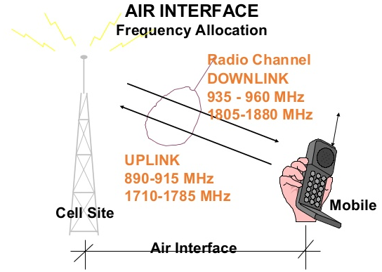
GSM Frequency Allocation
Uplink: is a frequency transmission that links mobile handset to base station
Downlink: is a frequency transmission that links base station to mobile handset
There are 4 major GSM frequency bands
850 MHz
900 MHz
1800 MHz
1900 MHz
Allocation of band
Country | Frequency Band
United States | 850 MHz and 1900 MHz
Rest of the world (Europe, Middle East, Africa, Asia) | 900 MHz and 1800 MHz

Slide 68
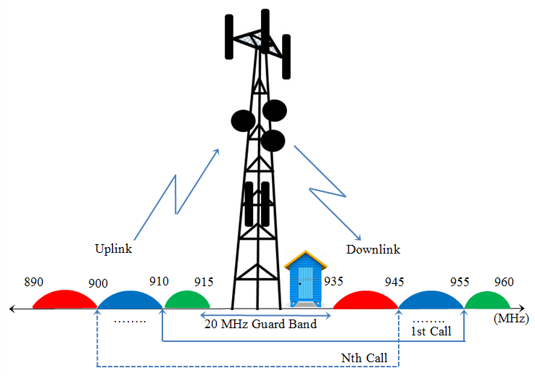
GSM bands in India
Each way the bandwidth for the GSM system is 25 MHz which provides 125 carriers uplink/downlink each having a bandwidth of 200 kHz.
For Uplink: 900 MHz of frequency is allocated.
Range: 890-915 MHz
For Downlink: 900 MHz of frequency is allocated.
Range: 935-960 MHz
Notes:
25000000/125=200000=200KHz

Slide 69
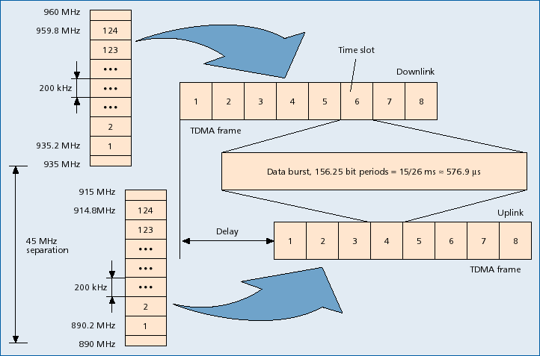
GSM bands :Carrier frequency and TDMA frames
GSM uses a combination of TDMA and FDMA encoding.
FDMA:124 channels of 200 kHz
TDMA:Burst
Freq. Carrier: 200 kHz
TDMA: 8 time slots per freq carrier
No. of carriers = 25 MHz / 200 kHz = 125
Max no. of user channels =125 * 8 = 1000
Practically, a guard band of 100 kHz is provided at the upper and lower end of the GSM and only 124 (duplex) channels are implemented.
Considering guard bands = 124 * 8 = 992 channels
Notes:
25000000/125=200000=200KHz

Slide 70
Authentication and Security
Authentication involves two functional entities:
SIM card in the mobile phone
Authentication Center (AUC)
For authentication; different algorithms used:
MS algorithm A3
Voice Privacy key algorithm A8
Strong over-the-air voice privacy algorithm A5
It used for ciphering and deciphering procedure for signaling, voice, and data.
So, signal, voice, data, and SMS within GSM networks ciphered over the wireless radio interface.

Slide 71
GTU Questions: Unit 3 GSM
Sr. | Question | Marks | Year
1. | Draw and explain GSM architecture. | 7 7 7 | Sum’19 Sum’20 Win’20
2. | Show the use of below GSM Identifiers. i) IMEI ii) IMSI iii) MSISDN iv) MSRN | 3 4 | Win’18 Win’20
3. | Illustrate different scenarios of Roaming and Handoff in GSM with proper Examples. OR Explain GSM call routing. | 7 7 | Sum’19 Win’19
4. | Compare GSM and CDMA technology. | 3 3 | Win’18 Sum’19
5. | Explain functional architecture of GSM system and types of services provided by GSM. | 7 | Win’18
6. | Explain handover process in cellular system. | 4 4 4 | Win’18 Sum’19 Win’20
7. | Explain the purpose of Home Location Register (HLR). List the information which is stored in Home Location Register (HLR). | 4 3 | Win’18 Win’19
8. | Explain Addresses and Identifiers used in GSM with Example. | 4,3 | Win’19,Sum’20

Slide 72

References
Book: | Mobile Computing Technology, Applications and service creation , Asoke K Telukder, Roopa R Yavagal by TMH
Web: | https://www.gsma.com/

Slide 73
Thank You

